Slide 1
Probability and Statistics with Reliability, Queuing and Computer Science Applications: Chapter 7 on Discrete Time Markov Chains
Kishor S. Trivedi
Visiting Professor
Dept. of Computer Science And Engineering.
Indian Institute of Technology, Kanpur

Slide 2

Discrete Time Markov Chain
Dynamic evolution is such that future depends only on the present (past is irrelevant); can depend on time step.
Markov Chain → Discrete state space.
DTMC : time (index) is also discrete, i.e., system is observed only at discrete epochs of time.
X₀, X₁, .., X_{n}, .. :observed state at discrete times, t₀, t₁,..,t_{n}, ..
X_{n} = j → system state at time step n is j.
  P(X_{n} = i_{n}| X₀ = i₀, X₁ = i₁, …, X_{n-1} = i_{n-1})
  = P(X_{n} = i_{n}| X_{n-1} = i_{n-1}) (Markov Property)
  p_{jk}(m,n) → P(X_{n} = k | X_{m} = j) , (conditional pmf)
  p_{j}(n) → P(X_{n} = j) (unconditional pmf) (first order)

Slide 3

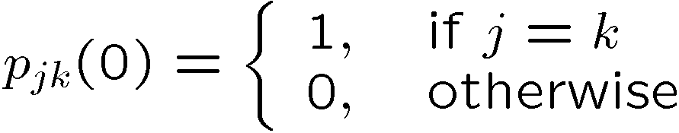
Transition Probabilities
p_{jk}(m,n): transition probability function of a DTMC.
Homogeneous DTMC: p_{jk}(m,n) = p_{jk}(n-m)
  1-step transition prob, p_{jk} = p_{jk}(1) = P(X_{n} = k| X_{n-1} = j) ,
  Assuming 0-step transition prob as:
Joint pmf (n^{th} order) : P(X₀ = i₀, X₁ = i₁, …, X_{n} = i_{n})
= P(X₀ = i₀, X₁ = i₁, …, X_{n-1} = i_{n-1}). P(X_{n} = i_{n}| X₀ = i₀, X₁ = i₁, …, X_{n-1} = i_{n-1})
= P(X₀ = i₀, X₁ = i₁, …, X_{n-1} = i_{n-1}). P(X_{n} = i_{n}| X_{n-1} = i_{n-1}) (due to Markov property)
= P(X₀ = i₀, X₁ = i₁, …, X_{n-1} = i_{n-1}).p_{in-1, in}
: = p_{i0}(0)p_{i0, i1} (1) …p_{in-1, in} (1) = p_{i0}(0)p_{i0, i1} …p_{in-1, in} = p_{i0}(0)p_{i0, in}(n)

Slide 4
The Beauty of Markov Chains
Given the initial probabilities
And
  the repeated use of one-step transition probabilities
  Or n-step transition probability
We can determine the n^{th} order pmf for all n

Slide 5
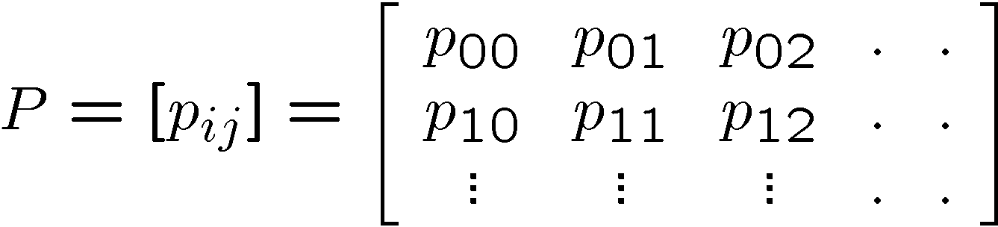
Transition Probability Matrix
The initial prob. p_{i0}(0) = P(X₀ = i₀ ). In general,
p₀(0) = P(X₀ = 0 ), …, p_{k}(0) = P(X₀ = k ) etc, or,
p(0) = [p₀(0), p₁(0), … ,p_{k}(0), ….] (initial prob. row vector)
Let the transition probability Matrix (TPM):
Sum of i^{th} row elements p_{i,0}(0)+ p_{i,1}(0)+ … ?
Such a square matrix with probabilities as entries and with row sums =1 is called a stochastic matrix (prop)

Slide 6
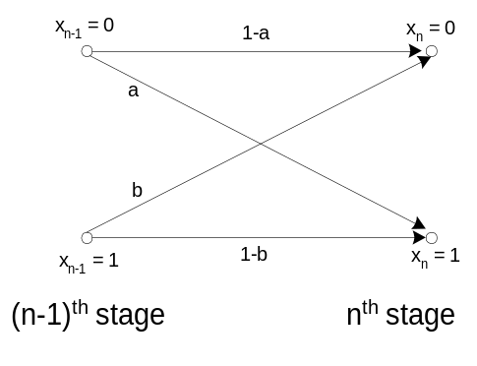
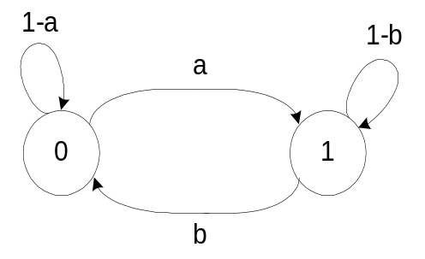
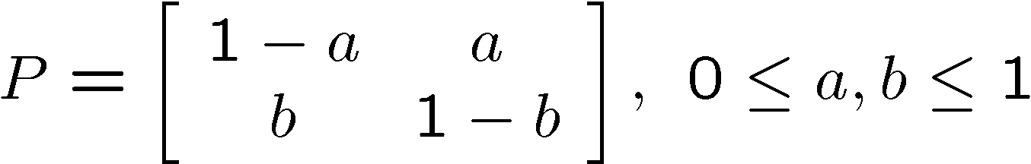
State Transition Diagram
Node with labels i, j etc. and arcs labeled p_{ij}
Example: 2-state DTMC for a cascade of binary comm. channels. Signal values: ‘0’ or ‘1’ form the state values.
i
p_{ij}
j

Slide 7
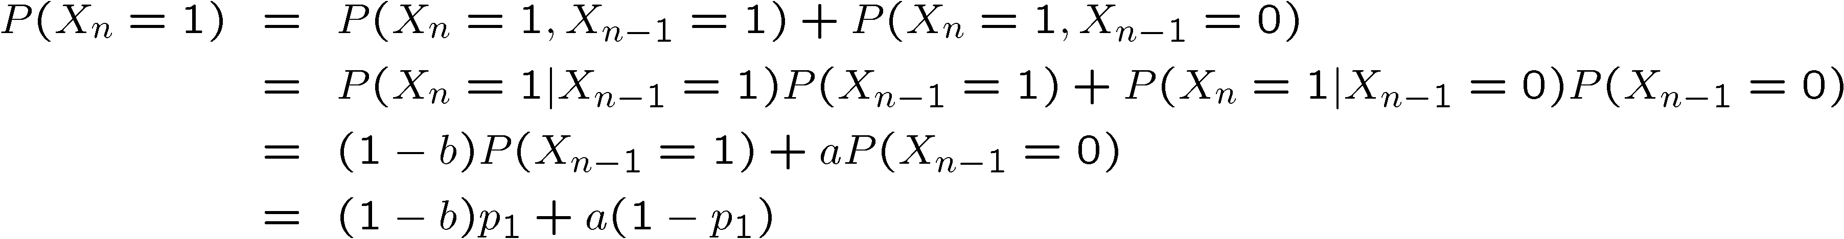
Unconditional Probability
Finding unconditional pmf:

Slide 8
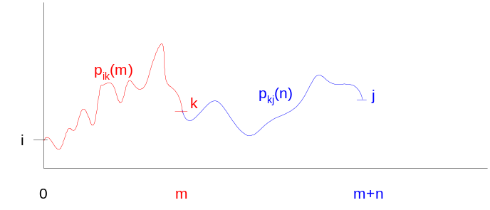
n-Step Transition Probability
For a DTMC, find
Events: state reaches k (from i) & reaches j (from k) are independent due to the Markov property (i.e. no history)
Invoking the theorem of total probability :
Let P(n) : n-step prob. transition matrix (i,j) entry is p_{ij}(n). Making m=1, n=n-1 in the above equation,
Notes:
We are interested in the event i → j, which is actually made up of two independent events, I→k and k→j. Therefore, p_{ij} = p_{ik}.p_{kj}

Slide 9
Marginal (unconditional) pmf
Quite often we are not interested in the joint pmf
But only the marginal pmf at step n
  Given the initial pmf
  And either the 1-step TPM or the n-step TPM
  Find the marginal pmf at step n

Slide 10
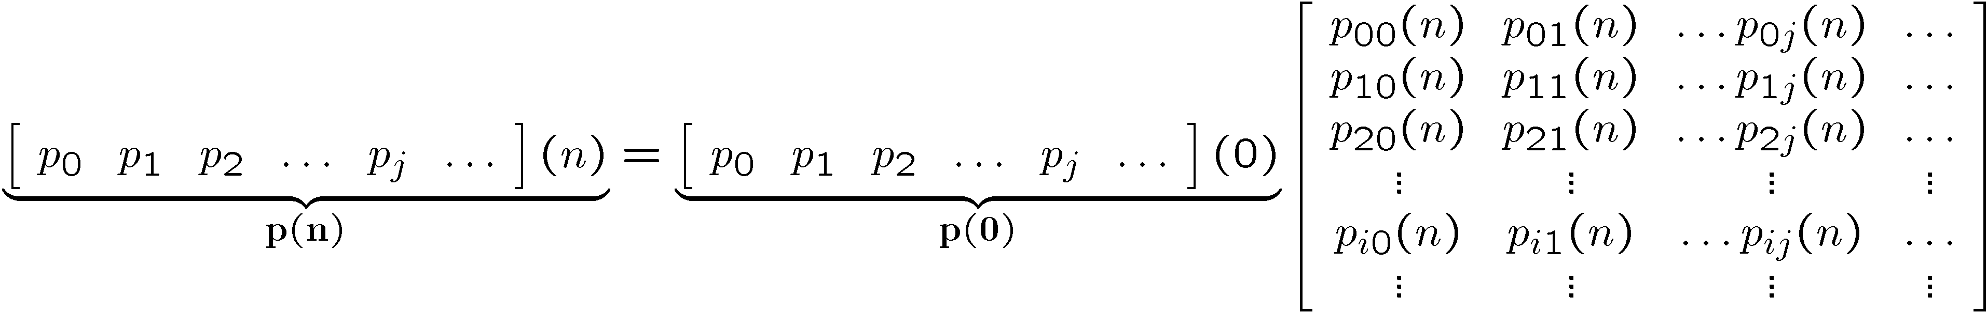

Marginal (unconditional) pmf
j, in general can assume countable values, 0,1,2, …. Defining,
p_{j}(n) for j=0,1,2,..,k,… can be written in the vector form as,
Or,
P ^{n} can be easily computed if I is finite. However, if I is countably infinite, it may be difficult to compute P ^{n} (and p(n) ).

Slide 11
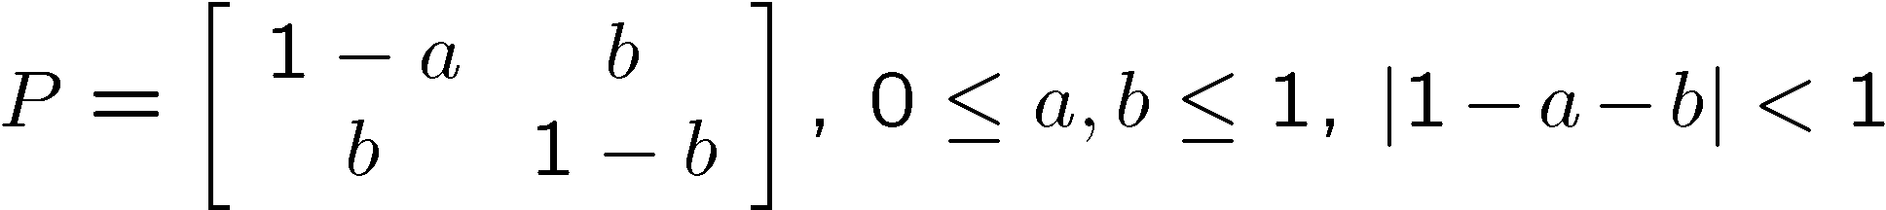
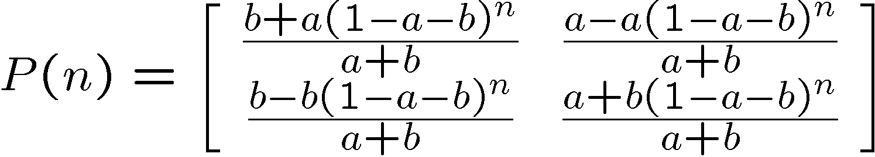
Marginal pmf Example
For a 2-state DTMC described by its 1-step transition prob. matrix,
the n-step transition prob. Matrix is given by,
Proof follows easily by using induction, that is, assuming that the above is true for P^{n-1}. Then,
P^{n} = P. P^{n-1}
Notes:
P(n) elements are:
p₀₀(n) p₀₁(n)
p₁₀(n) p₁₁(n)

Slide 12
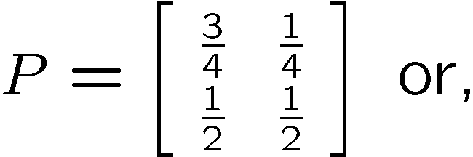
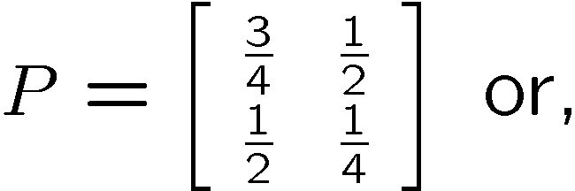
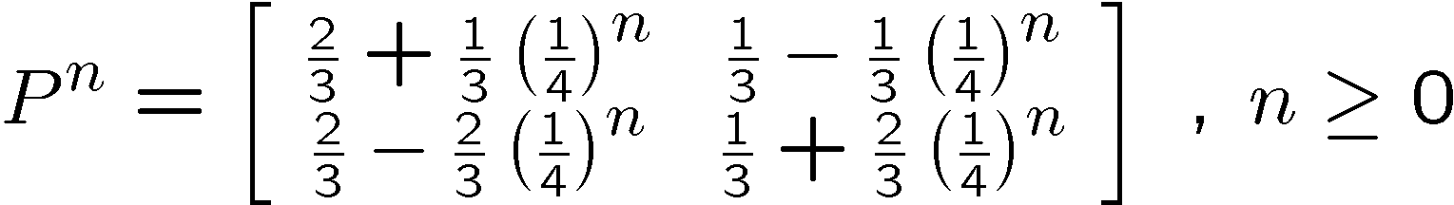


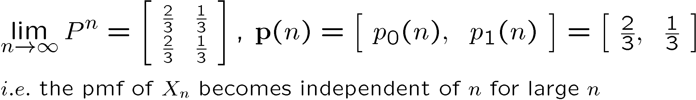
Computing Marginal pmf
Example of a cascade of digital comm. channels: each stage described by a 2-state DTMC, We want to find p(n) (a=0.25 & b=0.5),
The ’11’ element for n=2 and n=3 are,
Assuming initial pmf as, p(0) = [p₀(0) p₁(0)] = [1/3 2/3] gives,
What happens to P^{n} as n becomes very large (→ infinity)?
Notes:
if ‘1’ enters the 0th stage and comes out as ‘1’ after the 2nd stage with the prob. P(X2=1|X0=1) = 3/8

Slide 13
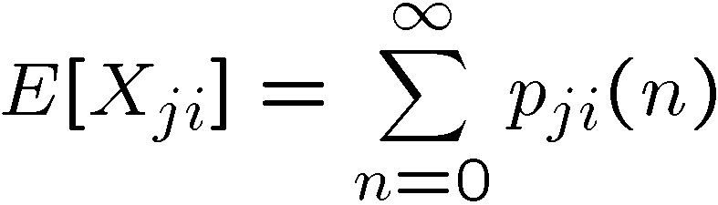
DTMC State Classification
From the previous example, as n approaches infinity, p_{ij}(n) becomes independent of n and i ! Specifically,
Not all Markov chains exhibit such a behavior.
State classification may be based on the distinction that:
  Average number of visits to some states may be infinite while other states may be visited only a finite number of times (on average)
Transient state: if there is non-zero probability that the system will NOT return to this state (or the average number of visits is finite).
Define X_{ji} to be the # of visits to state i, starting from state j, then,
For a transient state (i), visit count needs to finite, which requires p_{ji}(n) → 0 as n → infinity
Notes:
E[Xji] = sum_{n=0}^\infty pji(n) interpretation:
In 1-step = p_{ji} (1)
In 2-steps = p_{ji} (2) i.e. j → k (p_{jk}) and then k→i (p_{jk}) or p_{ji}(2) = p_{jk}.p_{ki}
In 1-step = p_{ji} (3) i.e. j → k1, k1→k2 and then k2→i etc.
Starting in state ‘j’, state ‘i’ can be visited via a number of paths (infinite many in general). Each of these paths contributes v_n=1 to the visit count. The probability of taking a particular path is p_{ji} (n), n=0,1,2,….. Therefor mean number of visits to state ‘i’ is = sum_{n=0}^{\infty} v_n p_{ji} (n).

Slide 14
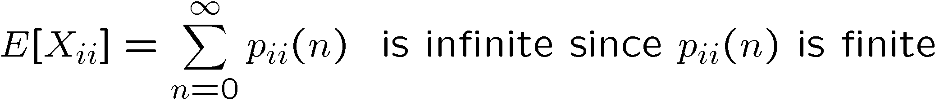
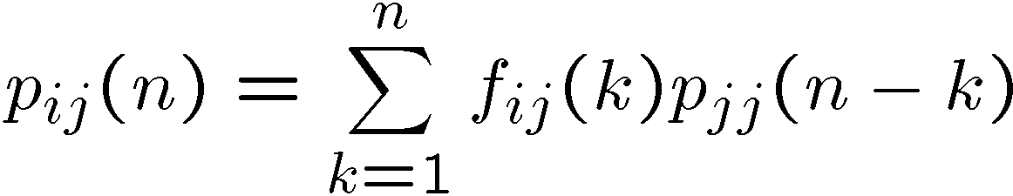
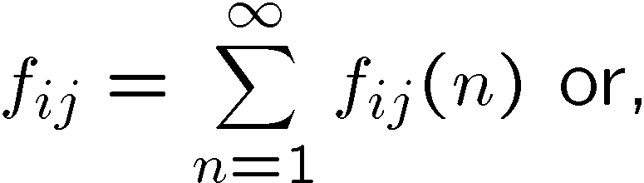
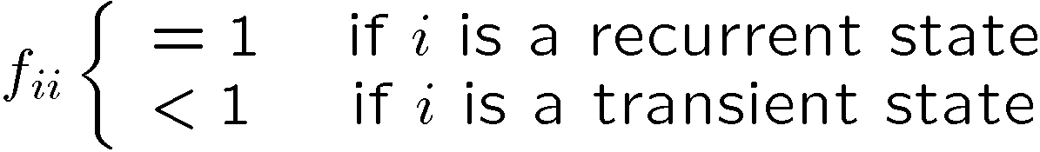
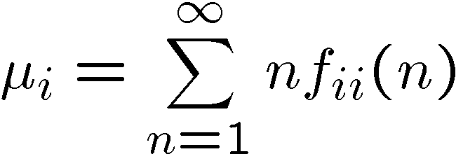
DTMC State Classification (contd.)
State i is a said to be recurrent if, starting from state i, the process eventually returns to the state i with probability 1.
For a recurrent state, time-to-return is a relevant measure. Define f_{ij}(n) as the cond. prob. that the first visit to j from i occurs in exactly n steps.
If j = i, then f_{ii}(n) denotes the prob. of returning to i in exactly n steps.
  Known result:
  Let,
  Mean recurrence time for state i is
Notes:
f_{ii}(n) : prob. Of returning to ‘i’ in n-steps, starting from state ‘i’.
Interpret this known result. For k=1, process takes 1-step (for i→j) AND the remaining (n-1) steps are spent in the state j
If k=2, it takes 2-steps to move from i to j & process spends rest of (n-2) steps in state j etc.

Slide 15
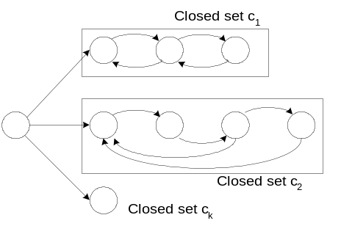
Recurrent state
Let i be recurrent and p_{ii}(n) > 0, for some n > 0.
For state i, define period d_{i} as GCD of all such +ve n’s that result in p_{ii}(n) > 0
If d_{i}=1, → aperiodic and if d_{i}>1, then periodic.
Absorbing state: state i absorbing if p_{ii}=1.
Communicating states: i and j are said to be communicating if there exist directed paths from i and j and from j and i.
Closed set of states: A commutating set of states C forms a closed set, if no state outside of C can be reached from any state in C.

Slide 16
Irreducible Markov Chains
Markov chain states can be partitioned into k distinct subsets:
c₁, c₂, .., c_{k-1}, c_{k} , such that
  c_{i}, i=1,2,..k-1 are closed set of recurrent nun-null states.
  c_{k} is the set of all transient states.
  If c_{i} contains only one state, then c_{i} is an absorbing state
  If k=2 & c_{k} empty, then c₁ forms an irreducible Markov chain
Irreducible Markov chain: is one in which every state can be reached from every other state in a finite no. of steps, i.e., for all i,j ε I, for some integer n > 0, p_{ij}(n) > 0. Examples:
  Cascade of digital comm. channels DTMC is irreducible
0
1

Slide 17
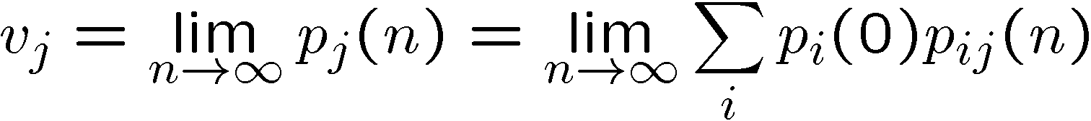
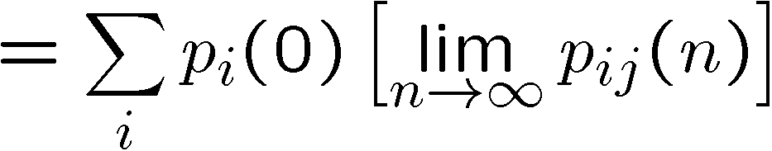
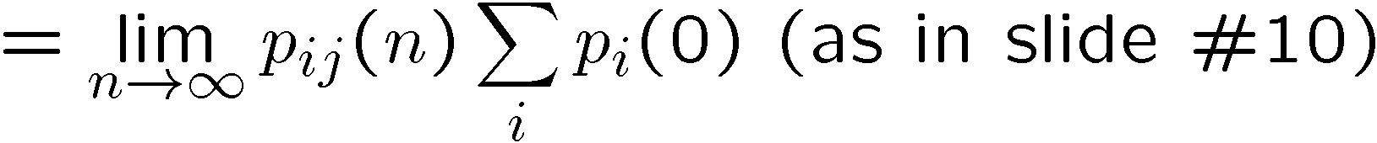
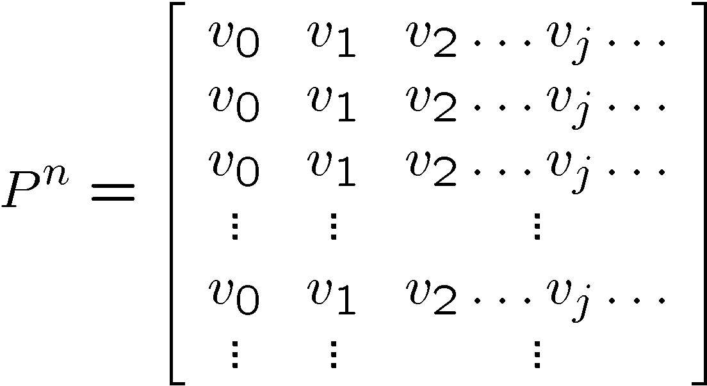
Irreducible DTMC (contd.)
If one state of an irreducible DTMC is recurrent aperiodic, then so are all the other states. Same result if periodic or transient.
For a finite aperiodic irreducible Markov chain, p_{ij}(n) becomes independent of i and n as n goes to infinity.
All rows of P^{n} become identical

Slide 18
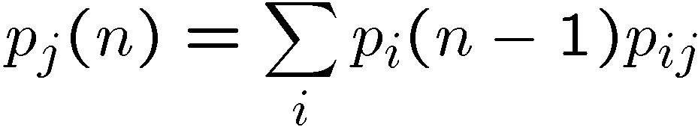
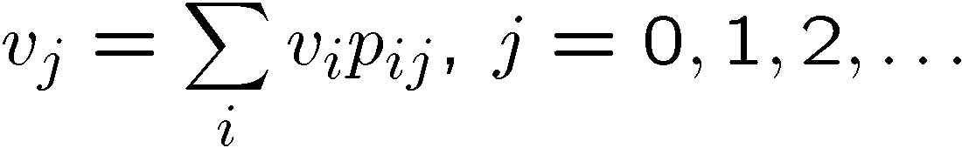
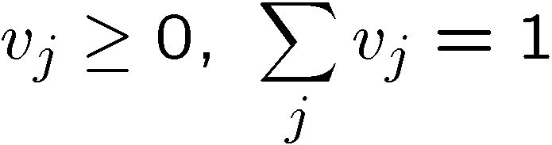
Irreducible DTMC (contd.)
Law of total probability gives,
Substitute in the 1st equation to get,
Or in the vector-matrix form,
Since v is a probability vector, we impose
Self reading exercise (theorems on pp. 351)
For an aperiodic, irreducible, finite state DTMC,

Slide 19
Eigenvalue & Eigenvector
λ is an eigenvalue of P iff
det(P- λI) = 0
λ =1 is an eigenvalue of a stochastic matrix P
x is an eigenvector of P corresponding to eigenvalue λ iff
x P=x λ

Slide 20
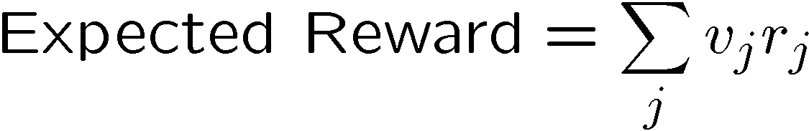
Measures of Interest
Attach reward r_{i} (cost or penalty) to state i enabling computation of various interesting measures
The steady-state expected reward is the weighted average of state probabilities:

Slide 21
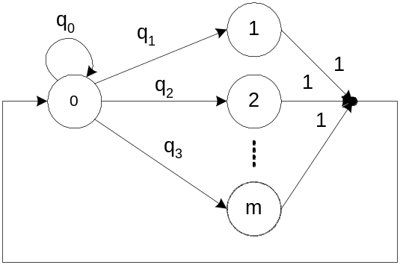
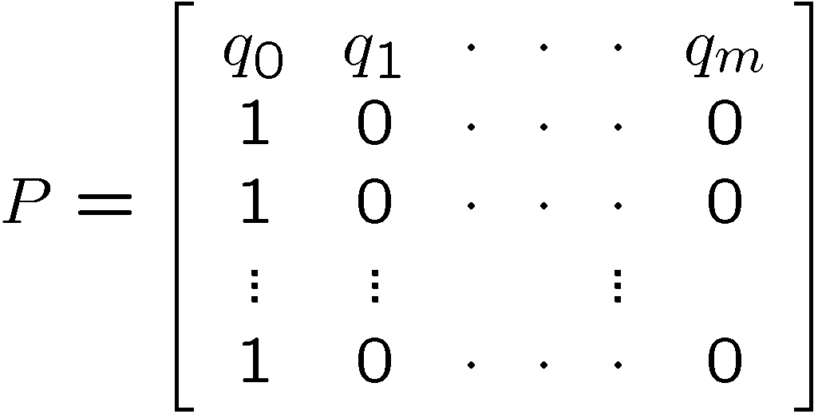

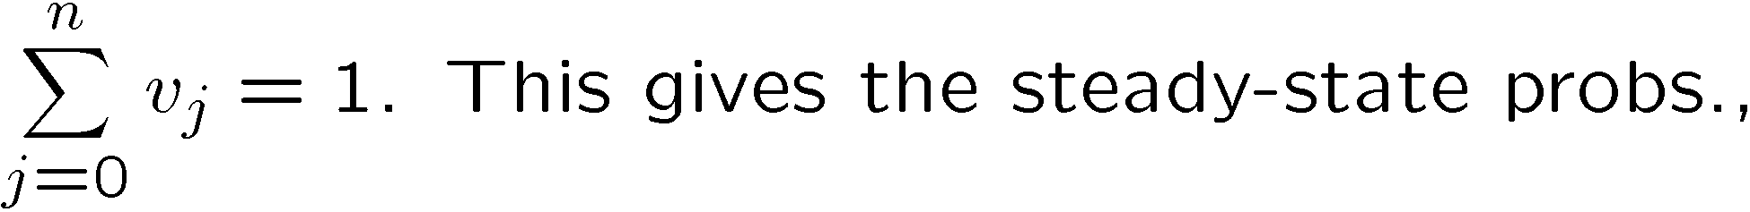
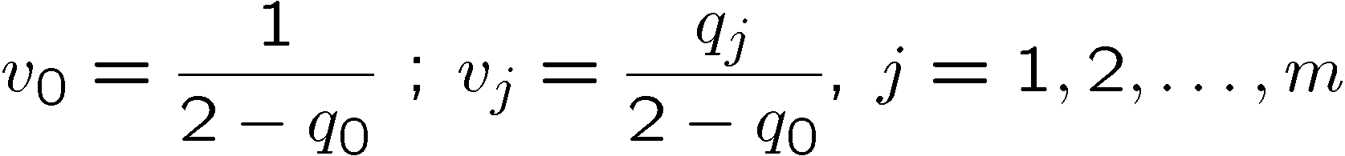
Irreducible DTMC Example
Typical computer program: continuous cycle of compute & I/O
The resulting DTMC is irreducible with period =1. Then from,

Slide 22
Performance Measures
Let t_{j} be the time to execute node j in the previous DTMC
Expected cycle time is obtained as the expected steady state reward by assigning r_{j} = t_{j}
Expected thruput is the reciprocal of the expected cycle time

Slide 23
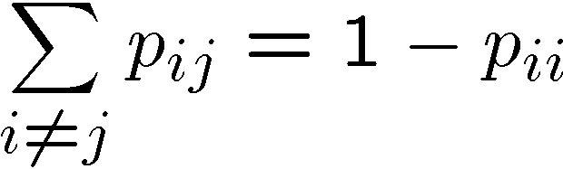
Sojourn Time; HDTMC
If X_{n} = i, then X_{n+1} = j should depend only on the current state i, and not on the time spent in state i.
Let T_{i} be the time spent in state i, before moving to state j
DTMC will remain in state i at the next step with prob. p_{ii} and,
Next step (n+1), BT, ‘0’→ X_{n+1} = i, ‘1’→X_{n+1} # i
Then T_{i} is the number of trials up to and including the first success :

Slide 24
Bernoulli Arrival Process
Many systems can be considered as discrete-time queues
Instead of a Poisson arrival process, we can use a Bernoulli arrival process
At every time step we have an arrival with probability c and no arrival with prob. 1-c
Generalize to MMBP, non-homogeneous BP, generalized BP

Slide 25
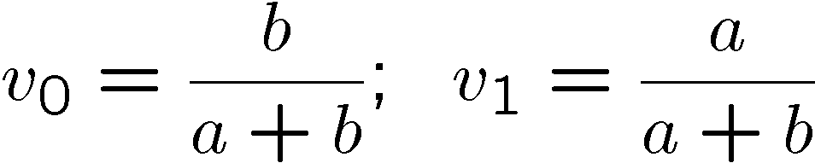
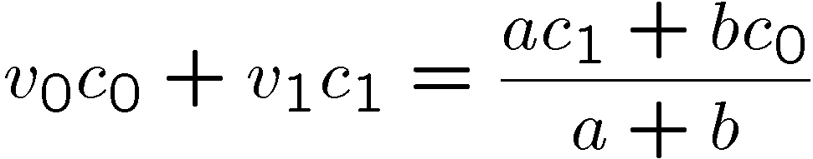
Markov Modulated Bernoulli Process (MMBP)
Generalization of a Bernoulli process: the Bernoulli process parameter is controlled by a DTMC.
Simplest case is Binary state (on-off) modulation
‘On’→ Bernoulli parameter = c₀; ‘Off’ → c₁’ (or =0)
Modulating process is an irreducible DTMC, and,
Reward assignment, r₀ = c₀ and r₁=c₁. Then cell arrival prob. is

Slide 26
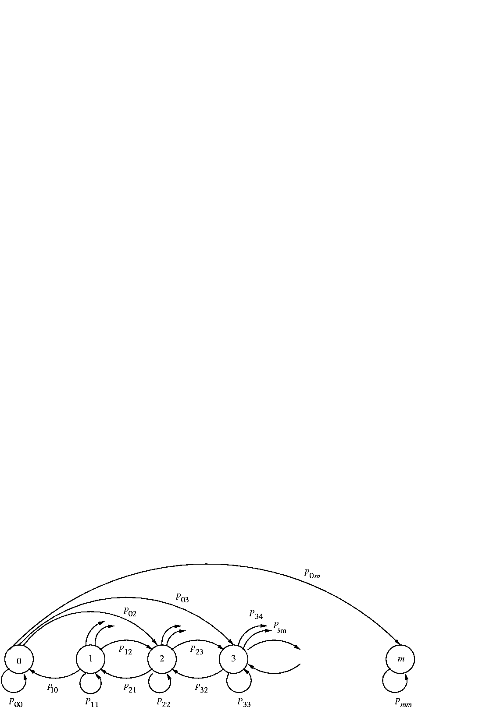
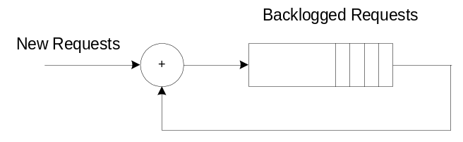
Slotted ALOHA DTMC
New and backlogged requests
Successful channel access if:
  Exactly one new req. and no backlogged req.
  Exactly one backlogged req. and no new req.
DTMC state: # of backlogged requests.
backlogged
new
+
n
+
m-n
+
x
x
x
x
+
Σ
Channel

Slide 27
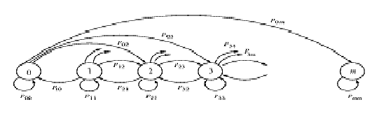
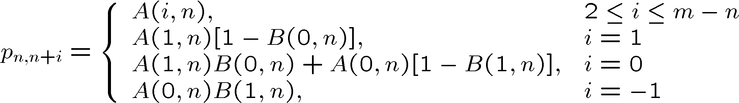
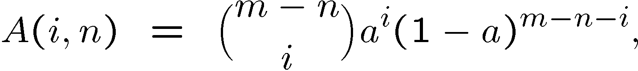

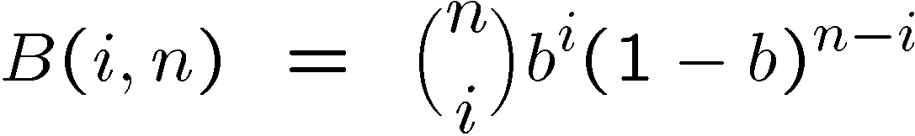

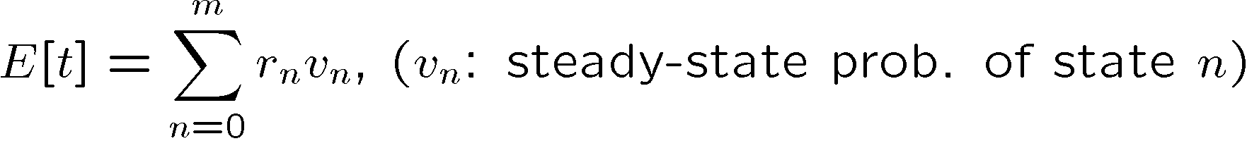
Slotted Aloha contd.
In a particular state n, successful contention occurs with prob. r_{n}
r_{n} may be assigned as a reward for state n.

Slide 28
Software Performance Analysis
Control structure point of view
  Chapter 5, also later in chapter 7
Data structure point of view
  Stacks, queues, trees etc.
  Probability of insertion b, probability of deletion d (generalized BP)
  Keep track of the number of items in the data structure (can be a vector)

Slide 29
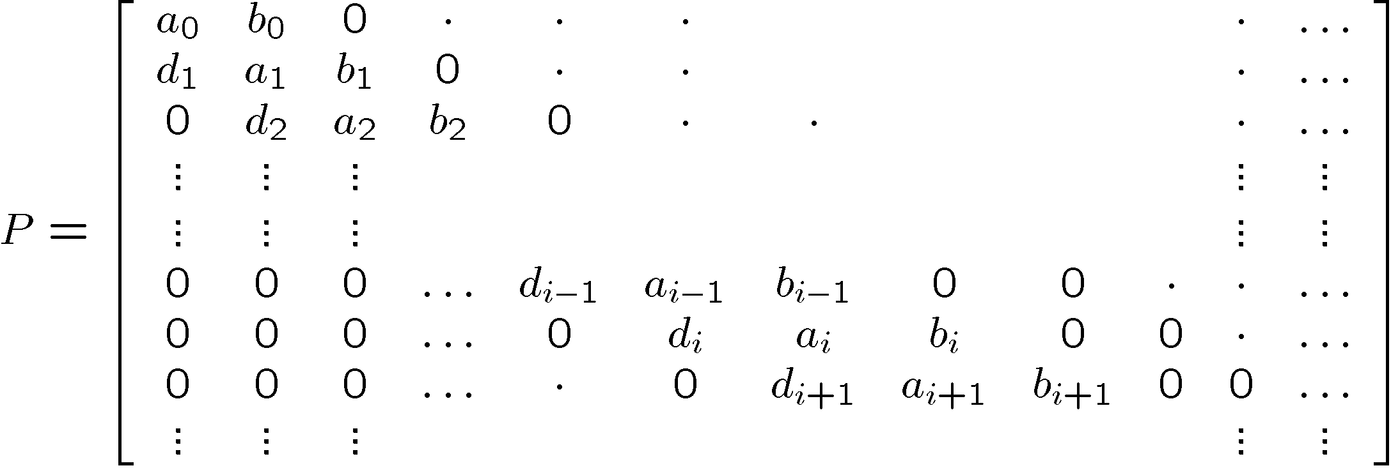

Discrete-time Birth-Death Process
Special type of DTMC in which the TPM P is tri-diagonal

Slide 30

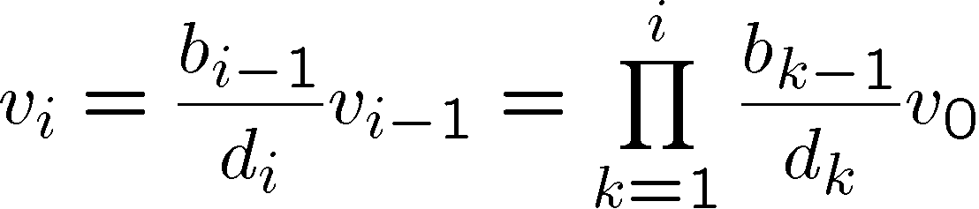
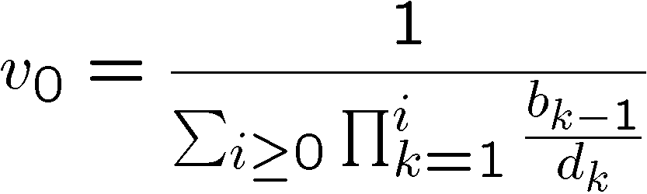
DTMC solution steps
Solving for v = vP, gives the steady state probabilities.

Slide 31
Data Structure Oriented Analysis
Can consider finite storage space and thence compute the probability of an overflow
Can be generalized two stacks sharing a common storage space or not sharing
More general data structures
Can consider the elapsed time between two requests to the data structure

Slide 32
Software Performance Analysis
Back to the control structure
But now allow arbitrary branching
Consider the control flow graph as a DTMC
Consider a terminating application

Slide 33
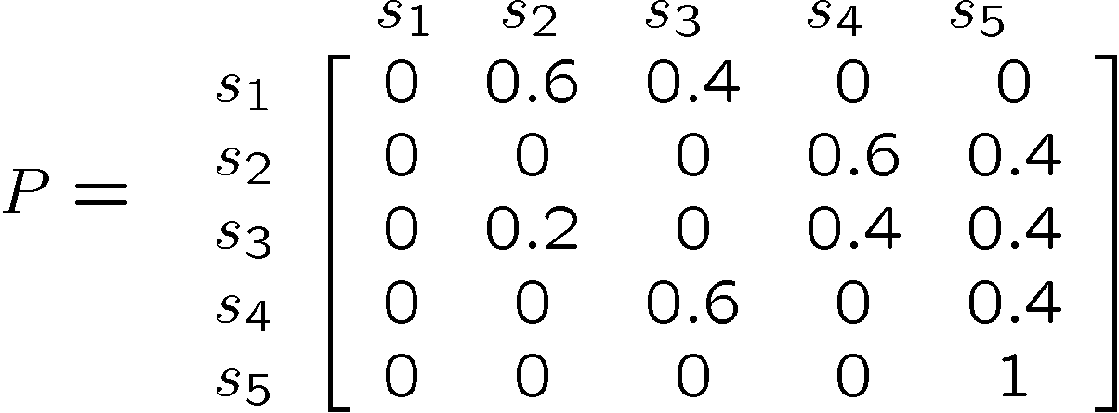

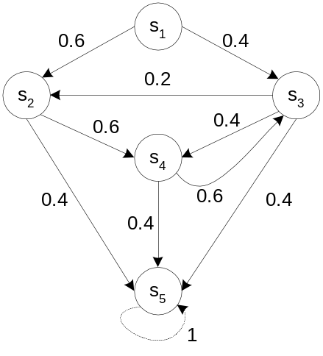
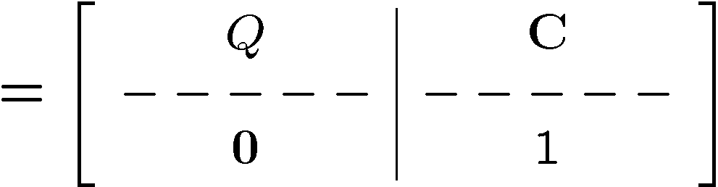
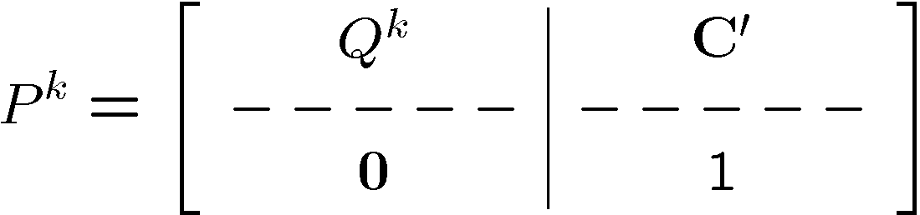




DTMC with Absorbing States
Example: Program having a set of interacting modules. Absorbing state: completion

Slide 34
DTMC with Absorbing States
M contains useful information.
  X_{ij} : rv denoting the number to visits to j starting from i
  E [X_{ij}] = m_{ij} (for i, j = 1,2,…, n-1) . Need to prove this statement.
  There are three distinct situations that can be enumerated
Let rv Y denote the state at step #2 (initial state: i)
  E[X_{ij}| Y = n] = δ_{ij}
  E[X_{ij}| Y = k] = E[X_{kj} + δ_{ij}]= E[X_{kj}]+ δ_{ij}
{
δ_{ij} , occurs with prob. p_{ij}
X_{kj} + δ_{ij} , occurs with prob. P_{ik}
k=1,2,..n
(δ_{ij} : term accounts for i=j case)
X_{ij} =
s_{i}
_{i}
s_{j}
s_{k}
s_{n}

Slide 35






DTMC with Absorbing States
Since, P(Y=k) = p_{ik} , k=1,2,..n, total expectation rule gives,
Over all (i,j) values, we need to work with the matrix,
Therefore, fundamental matrix M elements give the expected # of visits to state j (from i) before absorption.
If the process starts in state “1”, then m_{1j} gives the average # of visits to state j (from the start state) before absorption.

Slide 36


Software Performance/Reliability Analysis
By assigning rewards to different states, a variety of measures may be computed.
Average time to execute a program
  s₁ is the start state; r_{j} : execution time/visit for s_{j}
  V_{j} = m_{1j} is the average # times statement block s_{j} is executed
  We need to calculate total expected execution time, I.e. until the process gets absorbed into stop state (s₅ )
Software reliability: R_{j}: Reliability of s_{j .}Then,

Slide 37





Terminating Applications
Architecture: DTMC
Pr{transfer of control from module to module }
Failure behavior: component reliability
Solution method: Hierarchical
Compute the expected number
of times each component is executed using
Equation (7.76)

Slide 38


Terminating Applications
Cont’d
can be considered as the equivalent reliability
of the component that takes into account the component utilization
System reliability becomes

Slide 39
Architecture-Based Analysis
Example
Terminating application
architecture described by
DTMC with transition
probability matrix P=[p_{ij}]
component reliabilities are:
1
1
p₂₃
2
p₂₄
R₁
R₂
R₃
R₄
R₅
3
4
1
0.999
0.980
0.990
0.995
0.999
1
5

Slide 40
Architecture-Based Analysis
Example (contd.)
Solution method - Hierarchical
V_{i} is a clear indication of component usage
when p₂₄=0.8 components 2
and 4 are invoked within a loop
many times which results in
a significantly higher expected
number of executions compared
to the case when p₂₄=0.2
Application reliability is highly dependent on the components
usage
p₂₄
0.8
0.2
V₁
1
1
V₂
5
1.25
V₃
1
1
V₄
4
0.25
V₅
1
1
R
0.87536
0.97218

Slide 41
Architecture-Based Analysis
Example (contd.)
Solution method - Composite
1
1-R₁
P₂₄ | 0.8 | 0.2
R | 0.88056 | 0.96227
R₁
1-R₂
2
P₂₃ R₂
P₂₄ R₂
3
R₄
4
1-R₄
F
1-R₃
R₃
5
1-R₅
R₅
S

